Slide 1

OS LAB
Week 2

Slide 2
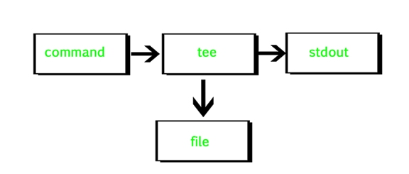
tee command
tee command reads the standard input and writes it to both the standard output and one or more files. The command is named after the T-splitter used in plumbing.
It basically breaks the output of a program so that it can be both displayed and saved in a file. It does both the tasks simultaneously, copies the result into the specified files or variables and also display the result.

Slide 3
Script Command
Script:
NAME
script - make typescript of terminal session
SYNOPSIS
script [-a] [-c COMMAND] [-f] [-q] [-t] [file]
DESCRIPTION
Script makes a typescript of everything printed on your terminal. It is useful for students who need a hardcopy record of an interactive session as proof of an assignment, as the typescript file can be printed out later with lpr(1).
Give exit the exit status that your script should have

Slide 4
Script Command
-a Append the output to file or typescript, retaining the prior contents.
-c COMMAND
Run the COMMAND rather than an interactive shell. This makes it easy for a script to capture the output of a program that behaves differently when its stdout is not a tty.
-f Flush output after each write. This is nice for telecooperation: One person does ‗mkfifo foo; script -f foo‘ and another can supervise real-time what is being done using ‗cat foo‘.
-q Be quiet.
-t Output timing data to standard error. This data contains two fields, separated by a space. The first field indicates how much time elapsed since the previous output. The second field indicates how many characters were output this time. This information can be used to replay typescripts with realistic typing and output delays.

Slide 5
Mkdir:
NAME
mkdir - make directories
SYNOPSIS
mkdir[OPTION]... DIRECTORY
Cd:
NAME
cd - To change directory - change the current working directory to a specific Folder.
SYNOPSIS
cd[Options][Directory]
DESCRIPTION
If directory is given, changes the shell's working directory todirectory. If not, changes to HOME (shell variable). If the shell variable CDPATH exists, it is used as a search path. If directory begins with a slash, CDPATH is not used. If directory is '-', this will change to the previous directory location (equivalent to $OLDPWD ). The return status is zero if the directory is successfully changed, non-zero otherwise.
OPTIONS Tag Description
-P Do not follow symbolic links
-L Follow symbolic links (default)

Slide 6
Rmdir:
NAME
rmdir - remove empty directories
SYNOPSIS
rmdir[OPTION]... DIRECTORY...
DESCRIPTION
Remove the DIRECTORY(ies), if they are empty.
OPTIONS TAG DESCRIPTION
--ignore-fail-on-non-empty ignore each failure that is solely because a directory is non-empty.
-p, --parents remove DIRECTORY and its ancestors; e.g., 'rmdir -p a/b/c' is similar to 'rmdir a/b/c a/b a'.
-v, --verbose output a diagnostic for every directory processed.
--help display this help and exit.
--version output version information and exit.

Slide 7
Cp:
NAME
cp - To copy one or more files to another location.
SYNOPSIS
cp[options]...SourceDest cp[options]...Source...Directory
DESCRIPTION
By default, sparse SOURCE files are detected by a crude heuristic and the corresponding DEST file is made sparse as well. That is the behavior selected by --sparse=auto. Specify --sparse=always to create a sparse DEST file whenever the SOURCE file contains a long enough sequence of zero bytes. Use --sparse=never to inhibit creation of sparse files.
The backup suffix is >, unless set with SIMPLE_BACKUP_SUFFIX. The version control can be set with VERSION_CONTROL, values are: t, numbered make numbered backups nil, existing numbered if numbered backups exist, simple otherwise never, simple always make simple backups. As a special case, cp makes a backup of SOURCE when the force and backup options are given and SOURCE and DEST are the same name for an existing, regular file.

Slide 8
Rm:
NAME
rm - remove files or directories
SYNOPSIS
rm[OPTION]... FILE...
DESCRIPTION
rm removes each specified file. By default, it does not remove directories. If the -I or --interactive=once option is given, and there are more than three files or the -r, -R, or --recursive are given, then rm prompts the user for whether to proceed with the entire operation.
If the response is not affirmative, the entire command is aborted. Otherwise, if a file is unwritable, standard input is a terminal, and the -f or --force option is not given, or the -i or --interactive=always option is given, rmprompts the user for whether to remove the file. If the response is not affirmative, the file is skipped.

Slide 9
Mv:
NAME
mv - move (rename) files
SYNOPSIS
mv [OPTION]... [-T] SOURCE DEST mv [OPTION]... SOURCE... DIRECTORY mv [OPTION]... -t DIRECTORY SOURCE...
Cat:
NAME
cat - Concatenate and print the content of files.
SYNOPSIS
cat[Options][File]...
DESCRIPTION
Cat command concatenate FILE(s), or standard input, to standard output. With no FILE, or when FILE is -, it reads standard input.
OPTIONS Tag Description
-A, --show-all equivalent to -vET
-b, --number-nonblank number nonblank output lines
-e equivalent to -vE
-E, --show-ends display $ at end of each line

Slide 10
grep : grep is an acronym for ‘globally search a regular expression and print it’.
The ‘$ grep’ command searches the specified input fully(globally) for a match with the supplied pattern and displays it. In the example, this would search for the word ‘picture’ in the file newsfile and if found,the lines containing it would be displayed on the screen.
$ grep picture newsfile
lpr : The ‘$ lpr’ command send a file to the printer for printing.
$ lpr new.txt

Slide 11
touch command::
The touch command is a standard command used in UNIX/Linux operating system which is used to create, change and modify timestamps of a file. Basically, there are two different commands to create a file in the Linux system which is as follows:
touch : The ‘$ touch’ command creates a file(not directory) and you can simple add an extension such as .txt after it to make it a Text File.
$ touch example $ ls Output: Desktop Documents Downloads Music Pictures Public Scratch Templates Videos example Note: It is important to note that according to the Unix File structure, Unix treats all the stuff it has as a ‘file’, even the directories(folders) are also treated as a file.You will get to know more about this as you will further use Linux/Unix based OS
cat command: It is used to create the file with content.
touch command: It is used to create a file without any content. The file created using touch command is empty. This command can be used when the user doesn’t have data to store at the time of file creation.

Slide 12
Umask command in Linux
The umask command in Linux is used to set default permissions for files or directories the user creates.
How does the umask command work?
The umask command specifies the permissions that the user does not want to be given out to the newly created file or directory.
umask works by doing a Bitwise AND with the bitwise complement(where the bits are inverted, i.e. 1 becomes 0 and 0 becomes 1) of the umask.
The bits which are set in the umask value, refer to the permissions, which are not assigned by default, as these values are subtracted from the maximum permission for files/directories.
Example:
$umask
0002
Here, the first digit, 0 is called the sticky bit, it is a special security feature.
The next three digits represent the octal values of the umask for a file or directory.
For a better understanding of umask working, we need to understand octal mode security settings.
The three rwx permissions (Read-Write-Execute) values are converted into three-bit binary values and represented by a single octal value as shown in the following table:

Slide 13
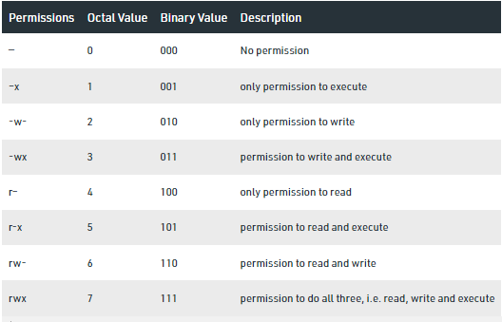
Umask

Slide 14
Let’s understand the above table with an example: Let’s explain the previous output we got using umask, 0002
For a better understanding of the above table, it might seem confusing at first, but it’s pretty simple, all you have to remember is the three modes, rwx (read-write-execute).
the bit for the respective mode, i.e. in 3-bit number, the first bit(leftmost) is for read, then write and execute respectively. In the above example, 0002 is outputted by the umask command, we will be not worrying about the first 0 as of now. the next three digits are 0 0 2.
Each digit here is for different classes of users, there are a total of 3 classes of users in Linux,
The owner
group members
everyone else
The above output (0 0 2) shows that the access to the owner is 0, access to the group members is 0, and access to everyone is 2. This 2 is an octal value, to understand the access permissions, we would have to convert it to decimal, 2 is equal to 010 in decimal, which can be clarified into 0 for read, 1 for write, and 0 for execute.
So we can conclude that the above output says – only write permissions for everyone.

Slide 15
How to set and update the default umask value?
We can set and update the default umask value using the command umask followed by a parameter, which should be an integer ranging from 000-777. The syntax for updating the umask value is the same as setting the umask value.
Setting the umask value:
We can use the umask command to set the default permissions with which the files/directories will be created.
Syntax
$umask 543

Slide 16
How to calculate umask values for files and directories?
Here, when we execute the command, the values are not directly allocated as 5 for the owner, 4 for the group members and 3 for the others, but the value we pass as an argument is subtracted from the max/full permission set. There are two full permission sets:
File -> The full permission set for a file is 666 (read/write permission for all)
Directory -> The full permission set for a directory is 777 (read/write/execute)
Note: The files cannot be given execution permissions by default as it can cause a security concern, and Linux systems are pretty much known for their amazing security, so that wouldn’t be good.
So, once we have set the umask value to 543, let’s see what happens when we make a directory(7-7-7) and a file(6-6-6)
Making a directory:
When we make a new directory, the permissions will be calculated as (full permissions for directory) – (umask value) i.e. 777 – 543 = 234

Slide 17
234, can be clarified more as:
2 for the owner, that is 010 in binary, so write permissions for the owner.
3 for the group members, that is 011 in binary, so write and execute permissions for the group members.
4 for everyone else, that is 100 in binary, so only read permission for everyone else.
The output shows the following: d-w–wxr–, which is a bit confusing, but when we simplify it, it can be seen as d -w- -wx r–, d here stands for directory and the latter 3 are the permissions for the respective users as we discussed in the previous point.
Making a file:
When we make a new directory, the permission will be given out similarly but with a slight change as follows: (full permissions for file) – (umask value) i.e. 666-543 = 123
Linux does not provide execute permissions by default, even if it is specified in the umask.
123 can be clarified more as:
1 for the owner, that is 001 in binary, so execute permission should be given to the owner, but Linux doesn’t give execute permission. Making a directory: s by default, so, the value is promoted by one and we get 010, and write permission will be granted to the owner.
2 for the group members, that is 010 in binary, so write permissions for the group members.
3 for everyone else, that is 011 in binary, so write and execute permission for everyone else, but again execute permission cannot be provided, so the value will be promoted one more time, and we will get 100, so read permission will be granted to everyone else.
The output shows, –w–w-r– which can be simplified as – -w- -w- r–, that is write for the owner, write for the group, and read for everyone else.
Now when we will try to open this file as the owner, we will get access denied, as the owner of the file only has access to write to it.

Slide 18
What is the difference between chmod and umask?
The umask command can be only used on new files i.e. while creating new files, any files created prior to using the umask command will have no effect.
The chmod command must be used on files that are already present, it is used to change the access permissions of files that have been created earlier.
Thus, we need umask command in order to set the default access permissions for files and directories which will be created in the future, and we need the chmod command in order to change the access permissions for files that have been already created and are present in the system.

Slide 19
chmod command:
In Unix-like operating systems, the chmod command is used to change the access mode of a file. The name is an abbreviation of change mode.
Syntax :
chmod [reference][operator][mode] file... The references are used to distinguish the users to whom the permissions apply i.e. they are list of letters that specifies whom to give permissions. The references are represented by one or more of the following letters:
Reference Class Description u owner file's owner g group users who are members of the file's group

Slide 20
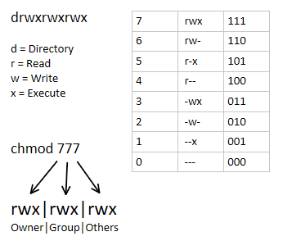

Slide 21
Chmod:
NAME
chmod - To change access permissions, change mode.
SYNOPSIS
chmod[Options]...Mode[,Mode]... file... Page | 30
chmod[Options]...Numeric_Mode file... chmod[Options]...--reference=RFile file...
DESCRIPTION
chmod changes the permissions of each given file according to mode, where mode describes the permissions to modify. Mode can be specified with octal numbers or with letters.
OPTIONS Tag Description
-f, --silent, --quiet suppress most error messages
-v, --verbose output a diagnostic for every file processed
-c, --changes like verbose but report only when a change is made
-c, --reference=RFile use RFile's mode instead of MODE values
-R, --recursive change files and directories recursively
--help display help and exit
--version output version information and exit

Slide 22
List all filenames starting with „a‟ or „b‟ or „m‟.
$ ls [abm] *
List all filenames that end with a digit.
$ ls * [0-9]
List all files in the current directory whose second character is a digit
$ ls ? [0-9]*
Use command(s) to create a directory in your home directory called KeepOut whose contents can
be read only by you
$ mkdir keepout ; chmod 400 keepout

